Slide 1

Capstone Project: Software QA Automation
DEPI Software Tester Track | Graduation Project 2026
Team: Ayman • Abdelrahman • Salma • Maryam

Slide 2










TESTING FOUNDATIONS & OBJECTIVES
ISTQB Principles
The 9 Pillars of Test Objectives
Testing shows presence of defects.
Evaluate
Trigger
Cover
Early testing saves time and money.
Work products (Reqs, Code)
Cause failures/find defects
Ensure required coverage
Defect clustering & Pareto Principle.
Mitigate
Verify
Validate
Reduce quality risks
Confirm requirements met
Check stakeholder needs
Goal: Reduce risk and ensure the system works as the customer requested.
Comply
Inform
Trust
Legal & Contractual proof
Data for decision making
Build confidence in quality

Slide 3

INTEGRATED TESTING STRATEGY
Testing Throughout SDLC
Testing is a continuous activity, not a final phase. It starts from Requirement Analysis using Static techniques.
•
Analysis: Boundary Value Analysis.
•
Tooling: Jira for Bug Lifecycle management.
Continuous Quality Feedback Loop

Slide 4

MANUAL TESTING STRATEGY
Why Manual First?
When to use:
Fundamental for new features and exploratory testing.
• Early project stages. • Unstable UI / Frequent changes. • Ad-hoc or one-time scenarios.
Real User Perspective (UX).
Exploratory Discovery.
Low Setup Cost for small suites.

Slide 5

AUTOMATION TESTING GOALS
Why Automate?
Scale the testing process for stability and high-speed delivery.
Fast Regression cycles.
Repeatable without human error.
Smoke & Sanity Stability.
Precision & Efficiency

Slide 6
MANUAL VS. AUTOMATION
Feature | Manual Testing | Automation Testing
Execution Speed | Slow / Time Consuming | Fast / Parallel
Reliability | Human Error Risk | High Precision
Cost | Low initial setup | High setup cost / ROI later
Suitability | Exploratory / UX | Regression / Stable Features

Slide 7

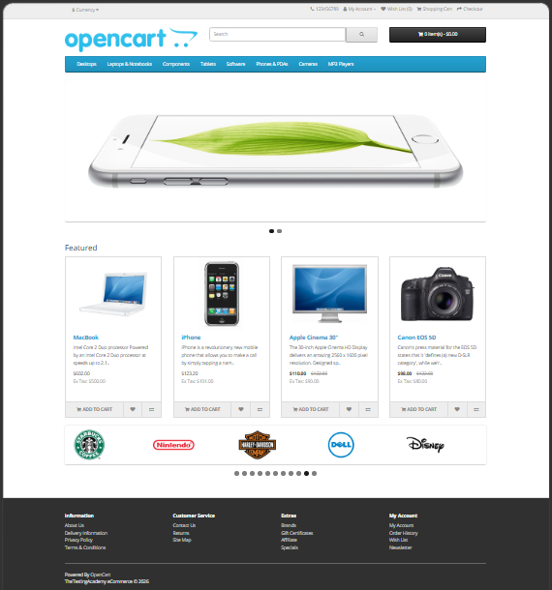
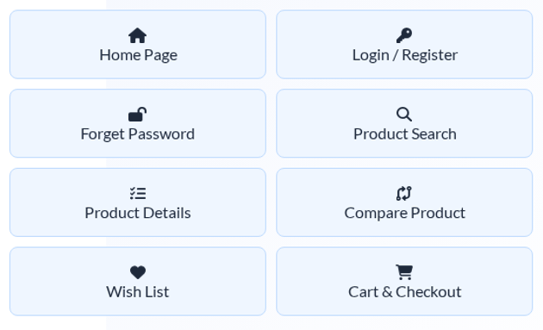




SYSTEM UNDER TEST: OPENCART
Electronics Store Domain
E-commerce platform specialized in high-tech products like MacBooks, Cameras, and Components.

Slide 8
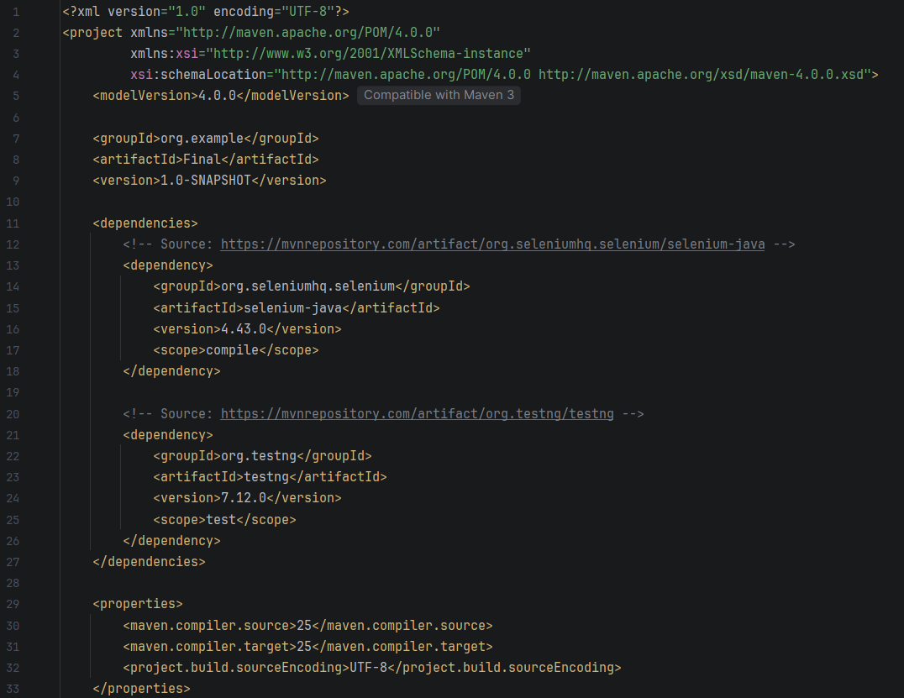


AUTOMATION STACK & PATTERN
Tools & Design
Implemented Page Object Model (POM) for modularity and easy maintenance.
•
Language: Java
•
Library: Selenium WebDriver
•
Framework: TestNG
•
Build Tool: Maven

Slide 9

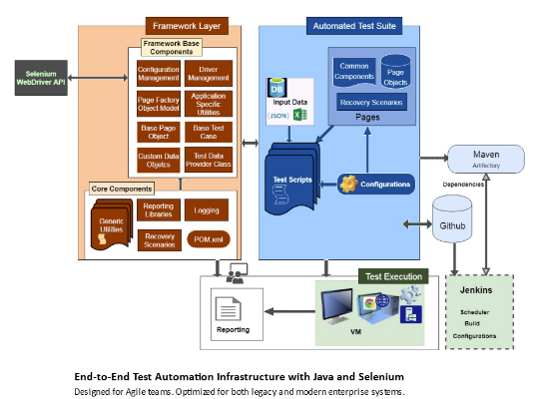
FRAMEWORK ARCHITECTURE
1. Base Class: WebDriver setup/teardown & Annotations.
2. Pages Package: Locators & Actions (Home, Login, Cart).
3. Tests Package: TestNG Cases (E2E Scenarios).

Slide 10


HANDLING FLAKINESS
Explicit Wait Solution
Synchronization issues often lead to flaky tests. We avoided Thread.sleep().
Explicit Waits: Dynamic wait for specific elements.
Wait until elementToBeClickable.
Synchronized Execution

Slide 11
VALIDATION STRATEGIES
Hard Assertions
Soft Assertions
Stops the test immediately on failure. Best for critical steps.
Continues execution even if failure occurs. Best for multiple UI checks.
Assert.assertEquals(actual, expected);
softAssert.assertAll();

Slide 12









END-TO-END SCENARIO
Product Details
Add to Cart
Assertion
Teardown
Search
Add to Cart
Assertion
Teardown
Verify MacBook specs & price
Click and wait for Success Msg
Check Cart widget quantity
Close Driver session
Result: Verified "Success: You have added MacBook to your shopping cart!"

Slide 13
Key Takeaways
Manual is the foundation of product understanding.
Automation scales quality and speed (Regression).
Framework modularity (POM) is critical for maintenance.
Thank You!
Ayman • Abdelrahman • Salma • Maryam

